Slide 1

Predicting the Persistency of a Drug (Healthcare)
Final Project Presentation
Name: Alexis Michael-Igbokwe
Internship Batch: LISUM-19
Group Name :Gold Standard Team
Data Science Internship

Slide 2
Problem Description
One of the challenge for all pharmaceutical companies is to understand the persistency of drug as per the physician prescription. To solve this problem ABC pharma company approached an analytics company to automate this process of identification
Objective: With an Objective to gather insights on the factors that are impacting the persistency, a classification model will be built for the given dataset.

Slide 3
About Dataset
The dataset presents 3424 registers and 69 features. The features include the target, 2 numerical and 66 categorical variables. There is no duplicated register nor missing values.
The ‘Persistency_Flag’ variable is the target variable and all the others are predictors. This variable presents two categories: Persistent and Non-Persistent. There are more registers for the NonPersistent category (62.4%).

Slide 4
Data insight from EDA
The dataset given is unbalanced
Skewness and outliers
Both numerical variables (‘Count_Of_Risks’ and ‘Dexa_Freq_During_Rx’) seems to be strongly correlated with the target, however, these variables are skewed and present outliers that need to be treated before proceeding with the modeling steps.
The 'Dexa_Freq_During_Rx' presents 116 and 693 outliers, whereas the ‘Count_Of_Risks’ presents 4 and 54 outliers considering the Non-Persistent and Persistent groups, respectively.
High proportion of unknown values
Four variables contain a great percentage of unknown values, but we don’t have very clear information about it and how to overcome the problem for now until further analysis is done.
Variables representing the same information
A few predictor variables seem to represent the same information, For example, the variables ‘Ntm_Speciality’, ‘Ntm_Specialist_Flag’ and ‘Ntm_Speciality_Bucket’ represent the same information and are highly correlated to each other. Therefore, correlated features will also be treated before the modeling steps.
Unbalanced dataset
As mentioned before, the target variable (‘Persistency_Flag’) presents more registers for the class ‘Non-Persistent’, and therefore, the data should be balanced prior modeling.

Slide 5
Categorical Variables
Most of patients that were receiving Dexa during Rx were persistent to the new drug, whereas most patients that were not receiving Dexa during Rx were classified as non-persistent.
A similar behavior was observed for the variables Comorb_Encounter_For_Screening_For_Malignant_Neoplasms, Comorb_Encounter_For_Immunization, and Comorb_Encntr_For_General_Exam_W_O_Complaint,_Susp_Or_Reprtd_Dx.
The other 5 variables, including Comorb_Long_Term_Current_Drug_Therapy, Comorb_Other_Disorders_Of_Bone_Density _And_Structure, Concom_Systemic_Corticosteroids_Plain, Comorb_Other_Joint_Disorder_Not_Elsewhere_Classified, Concom_Anaesthetics_General, presented higher number of negative values compared to positive (‘yes’) for both target classes, however in a higher proportion for the non-persistent patients.

Slide 6
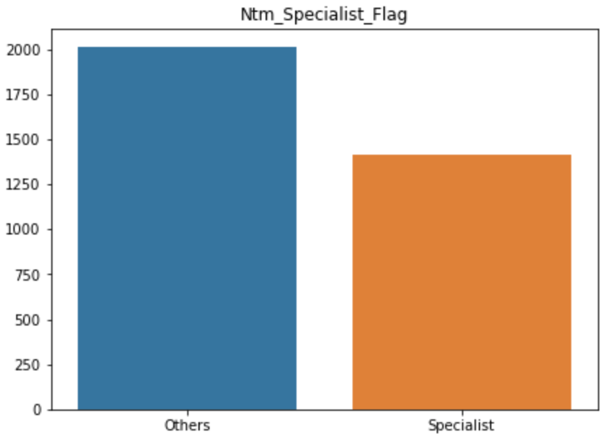
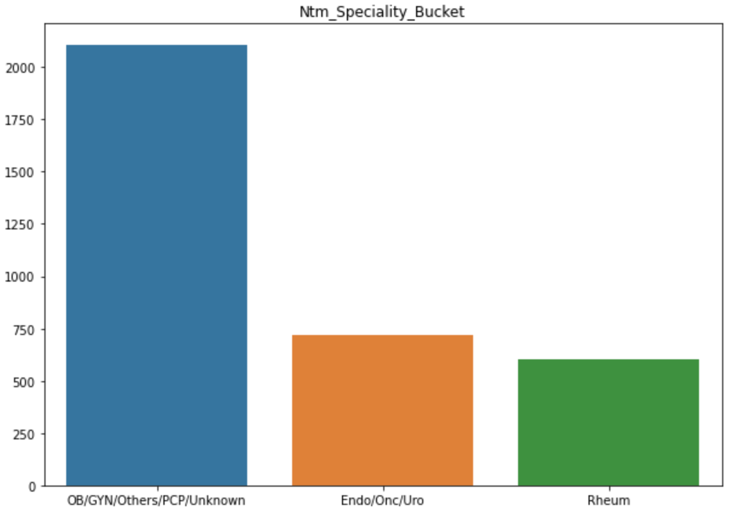
NTM_Speciality Variables
All the Ntm_Speciality variables were correlated to each other, of which the Ntm_Specialist_Flag seems to better represent this category of variables in a simpler manner with only 2 categories. Similar correlation was observed for many other pairs of variables.

Slide 7
Possible Potential key Indicators for Data Modelling
Top 10 predictors with higher correlation significance with the target:
Dexa_During_Rx
Comorb_Long_Term_Current_Drug_Therapy
Comorb_Encounter_For_Screening_For_Malignant_Neoplasms
Comorb_Encounter_For_Immunization
Comorb_Encntr_For_General_Exam_W_O_Complaint,_Susp_Or_Reprtd_Dx
Comorb_Other_Disorders_Of_Bone_Density_And_Structure
Concom_Systemic_Corticosteroids_Plain
Comorb_Other_Joint_Disorder_Not_Elsewhere_Classified
Concom_Anaesthetics_General
Concom_Viral_Vaccines

Slide 8
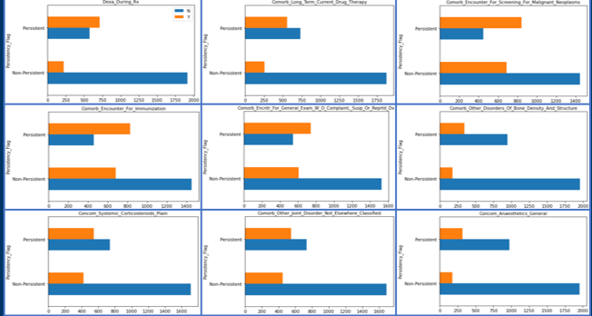
Data Distribution Amongst Potential Indicators

Slide 9
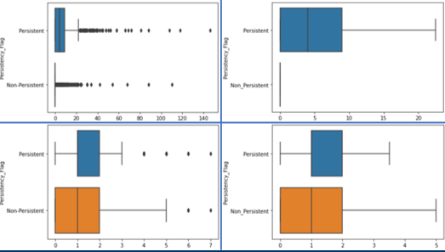
Numerical Variables Before and Outliers Treatment
Dexa_Freq_During_Rx and Count_Of_Risks
 | Dataset Before Transformation | Dataset After Transformation (approach 2)
Dexa_Freq_During_Rx
Count_Of_Risks

Slide 10
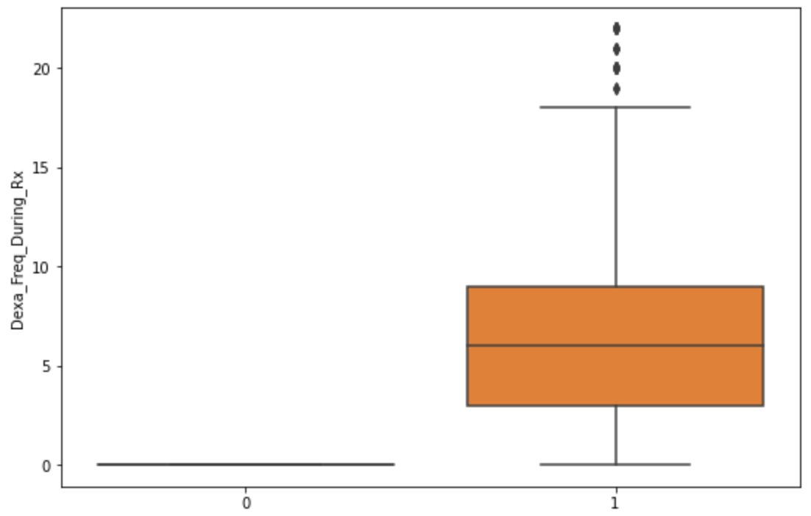
Numerical Variables
Correlation of Dexa_Freq_During_Rx and Dexa_During_Rx
Correlation (t-test) of Target with Dexa_Freq_During_Rx
p-value = 1.054 e-90
Note: Since both variables show significance correlation it is better to choose Dexa_During_Rx to make dataset more homogenous.

Slide 11
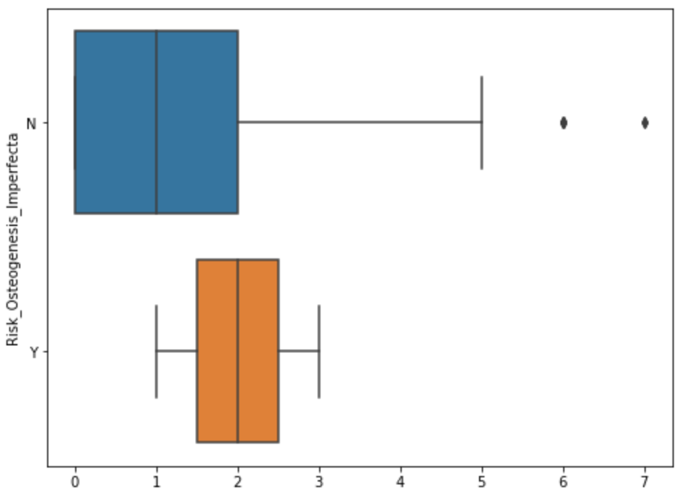
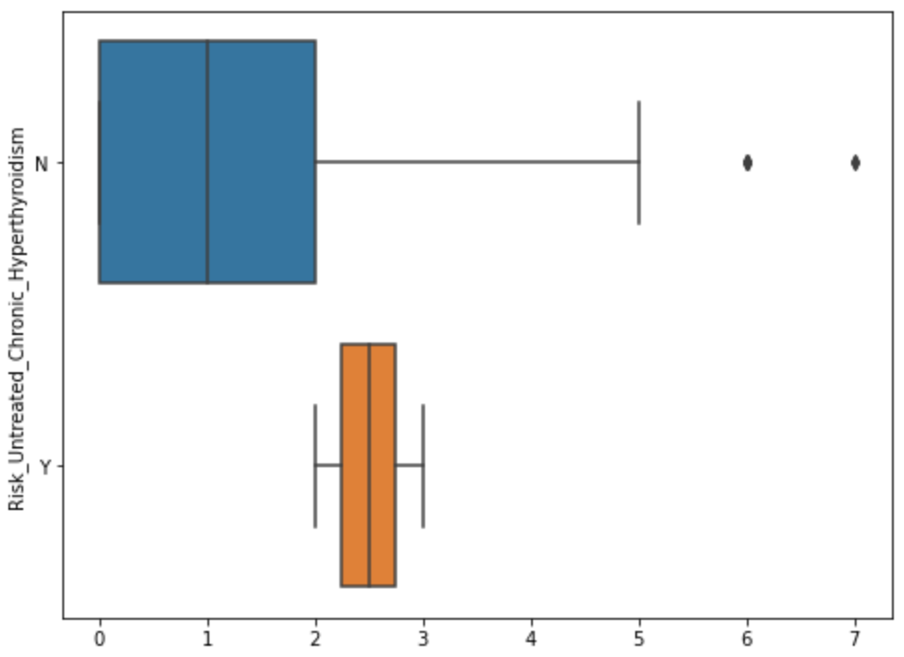
Numerical Variables
Correlation of Count_Of_Risks and other Risk Related Variables
With exception to the variables Risk_Osteogenesis_Imperfecta and Risk_Untreated_Chronic_Hyperthyroidism (figure below), all the other risk-related variables presented a significant correlation with the Count_Of_Risks. However, these variables are correlated with other risk-related variables. It is better to choose few categorical risk that are highly correlated to target variable.

Slide 12
Feature Selection
The Feature Selection was performed using various methods. They are as follows:
Features Directly Selected from EDA based on Chisquare, T and Z-tests
Features Selected Using SelectKBest with Mutual Info and Chisquare tests.
Performing Dimensionality Reduction using PCA and ICA
The Features selected from SelectKBest with Mutual Information tested against ‘SVC’, ‘RandomForest’ and ‘Dense Neural’ Network seems to perform well with better accuracy, precision and F1 Score compared to other models.

Slide 13
The Features selected
Ntm_Speciality','Dexa_During_Rx
Frag_Frac_During_Rx
Tscore_Bucket_During_Rx
Comorb_Encounter_For_Screening_For_Malignant_Neoplasms
Comorb_Encounter_For_Immunization
Comorb_Encntr_For_General_Exam_W_O_Complaint,_Susp_Or_Reprtd_Dx
Comorb_Other_Joint_Disorder_Not_Elsewhere_Classified
Comorb_Long_Term_Current_Drug_Therapy', 'Comorb_Dorsalgia
Comorb_Personal_History_Of_Other_Diseases_And_Conditions
Comorb_Other_Disorders_Of_Bone_Density_And_Structure
Comorb_Osteoporosis_without_current_pathological_fracture
Comorb_Gastro_esophageal_reflux_disease
Concom_Systemic_Corticosteroids_Plain
Concom_Cephalosporins
Concom_Macrolides_And_Similar_Types
Concom_Broad_Spectrum_Penicillins
Concom_Anaesthetics_General
Concom_Viral_Vaccines

Slide 14
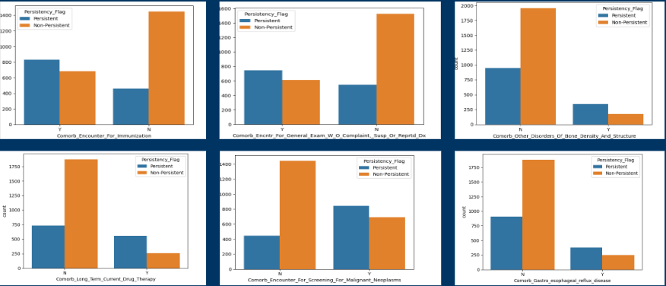
Features from Select-Kbest using mutual information

Slide 15
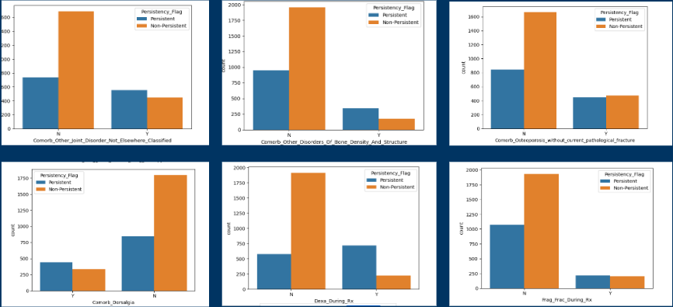
Features from Select-Kbest using mutual information

Slide 16
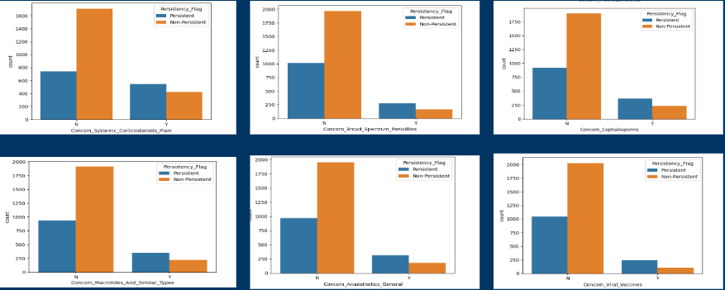
Features from Select-Kbest using mutual information

Slide 17
Model Selection
For this project, Different type of models were utilised that, they are as follows:
SVC.
RandomForest.
Dense Neural Network(Customised).
Against Three Different Feature Selection Methods mentioned previously, It was found that Random Forest trained with Features from SelectKBest using Mutual Information with RandomisedSearch Hyperparameter Tuning has produced better results compared to other models.
The Metrics are as follows for RandomForest Classifier:
Accuracy: 0.80
F1-score: 0.73
Precision: 0.69
ROC-AUC: 0.79

Slide 18
Recommendations
It is clearly visible that the Comorb Features are very important when deciding the persistency of drug, but given the collinearity among themselves leads to having more redundant or un-wanted information and it is better to include those features that describes diversity in a dataset and leads to better prediction.
The number of records compared to columns are less which is not ideal for model training, this led to an accuracy of less than 90%.
A data imbalance observed and after trying different oversampling, undersampling methods the model training didn’t seem to improve much. Also, there are features like race, Region etc., where most of the data is concentrated on one type of category which may not be ideal for output predictions, as model would is suitable using a particular type of data or it gets biased during prediction.
It is always recommended to include features that has even distribution, if possible among all variables.

Slide 19
API FOR MODEL PREDICTION LINK(FastAPI): http://35.179.88.8/docs

